Slide 1

AMAzon cAMPUS MENTORSHIP SerIES
(ACMS)

Slide 2
PROJECT NAME : SUPPLY MANAGEMENT PORTAL
TEAM MEMBERS:
1) Manisha Satheesh
2) Raaghavi Shanmugasundaram
3) Swathi ChandraSekaran
4) Manimozhi Sadasivam
5) Aishwarya Sathyakumar
UNIVERSITY:
COLLEGE OF ENGINEERING GUINDY,
ANNA UNIVERSITY(CEG)
MENTOR:
Jayanthan

Slide 3
PROJECT DESCRIPTION
This project aims at providing a mobile application that allows the customer to manage their daily needs such as newspaper, milk ,magazines and water subscription digitally. The customer has to sign up for the first time by providing his/her personal details like name, age, email-id, residential address .The customer has to manage his/her account securely. So the customer is asked to enter a password and on successful completion of account creation he/she is generated a unique account id.
Once the customer gets on boarded to the portal ,the customer can manage his/her preference regarding the requirement of daily supplies. This will be periodically reported to the respective vendor ac-cumulatively. This project allows the customer to opt-in or opt-out of the subscription on the daily basis.

Slide 4
PROBLEM STATEMENT
In the present world, there are so many applications such as online ticket booking app, movie booking app, online banking portal and so on. The presence of these applications makes our daily life easier.
Till this day, there haven't been any software developed to manage the daily supplements like milk, news paper and water .Even though we are able to book the flight tickets from home, we are not able to customize our daily needs.

Slide 5
SOLUTION
Our project "SUPPLY MANAGEMENT PORTAL" which aims at helping out the customers in customizing their daily needs from their home.
Anyone can use this particular application provided they have created their account successfully. According to the area the customer lives ,the vendors and their details like supply rates etc.,will be displayed for various services. And it is the customer's wish to choose between the various vendors.

Slide 6
Product Functions
For the customer portal:
Customer can sign up for the first time by entering his details like name, email id, address.
Customer can set up the password for that particular customer id generated.
The application lists out the vendors in that particular area.(by taking the address)
The customer can choose the vendor by clicking on it. The vendor's details will be shown to the customer. And the corresponding vendor gets the information about the customer.
The customer can choose various vendor for various supplies.

Slide 7
CONTINUED
The customer's needed regular supply is recorded by the vendor for milk, newspaper and water
The customer can customize the supplies needed a week before.
If the customer is going out of station, there is a particular option in which he can fill in the details like how many days he won't be home and so on.
At the end of the month, the customer will be generated a bill.
The app is linked to Paytm where the customers can pay their bills .

Slide 8
For the Vendor Portal
The vendors must first register themselves along with their domain name in this portal.They will get their domain id once they have registered and validated.
During the registration process they must provide the address and the area in which they will provide their service.
They must mention the products they sell with the quantity and should mention the quoted price for the product.
The bill for each customer will be generated automatically and copy of it will be sent to the vendor where the payment will be made online.Obviously the vendor should have a bank account to receive the payment and should mention their account details during the registration process.

Slide 9
ASSUMPTIONS AND DEPENDENCIES
For now, the finished project would be in the form of an application.
The queries of the users will be updated only when the user is online.
For the ease of customers we had idea of integrating for managing the users subscriptions.

Slide 10
Benefits of vendors
Their basic requirement is the automatic billing system where the bill will be generated for each and every customer at end of every month.The payment will be made online so that there is no need for the vendors to go house by house to collect the money. The main usage of this application is that requirement of the supplies will be updated each day for the vendors so that it will be easy for them as it saves their time on the delivery.

Slide 11
Benefits of customers
Their basic requirement of the customers is their online payment system and easy access to different vendors. This helps them pick their needed product and the vendors in their finger tip. The payment is very easy and can be done whenever they find just 2 minutes of time

Slide 12
SYSTEM REQUIREMENTS
The system requires a database that maintains the details of both the customers and the vendors separately. The database is updated periodically and the bills of each customer will be updated. The system meets the requirements of both the customer and the vendor side.

Slide 13
EXTENSIONS
First starting with the newspaper supply management this project can be extended to milk supply, magazine supply, water supply and even to the supply of vegetables and fruits.

Slide 14
ScREENSHOTS of application

Slide 15
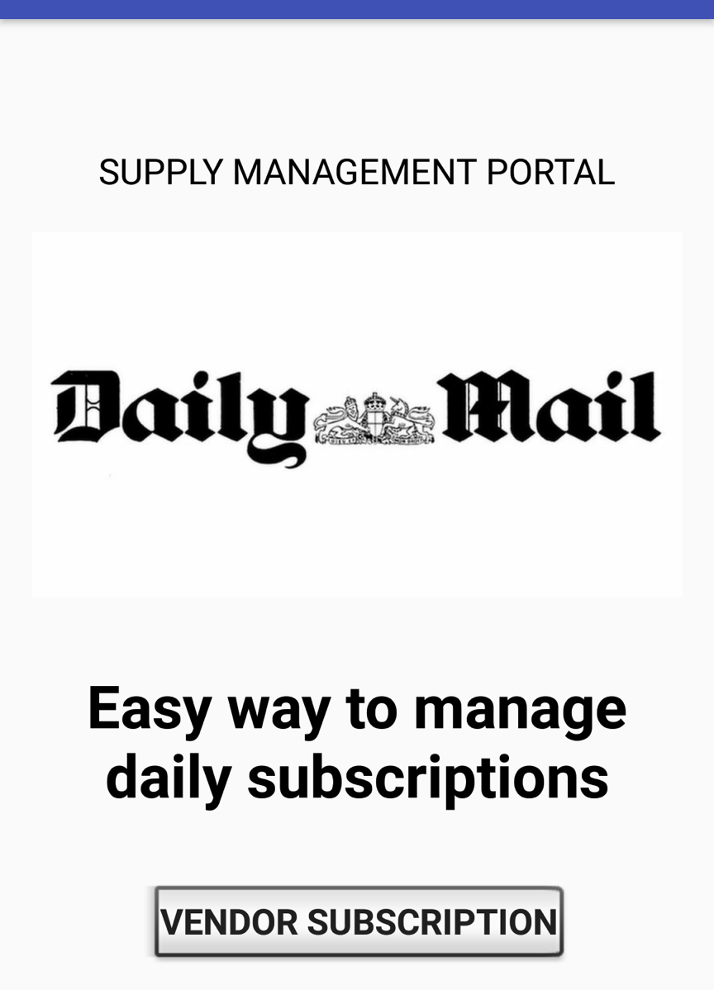
Initial screen

Slide 16
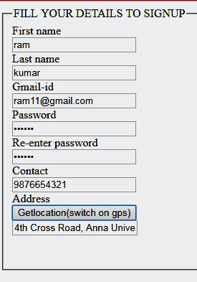
Sign up page
Here the address is fetched through "GPS "in the corresponding mobile phone for accuracy

Slide 17
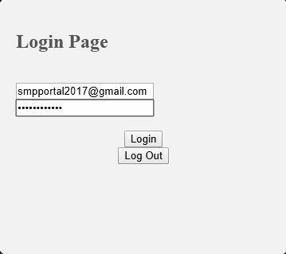
Customer login

Slide 18
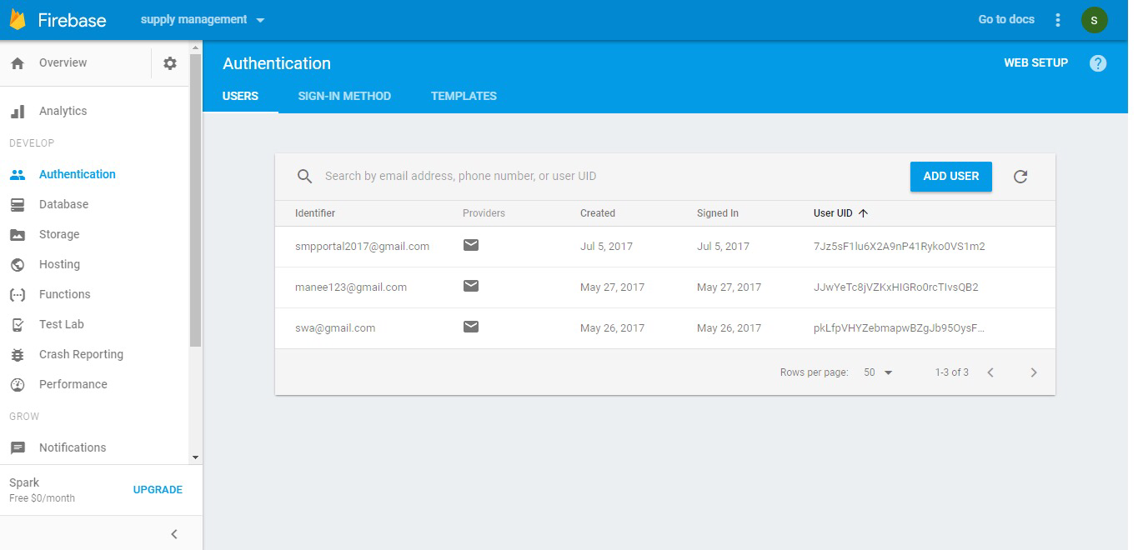

Slide 19
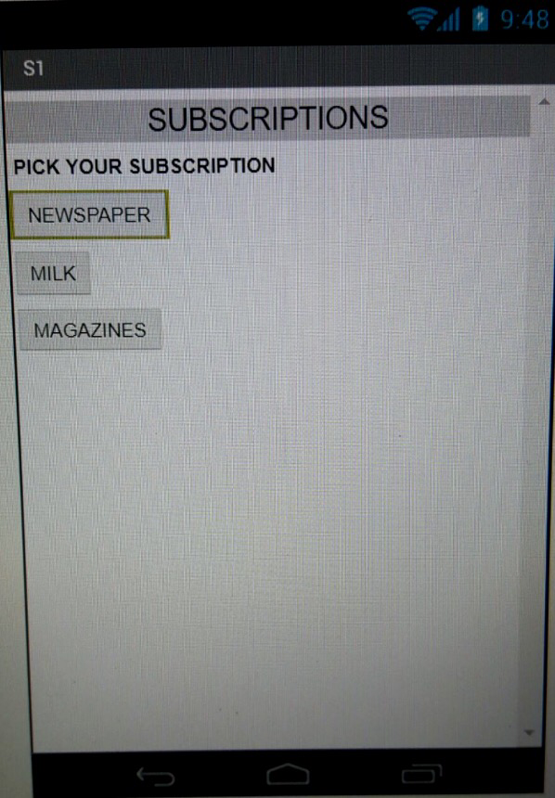
SUBSCRIPTION Selection

Slide 20
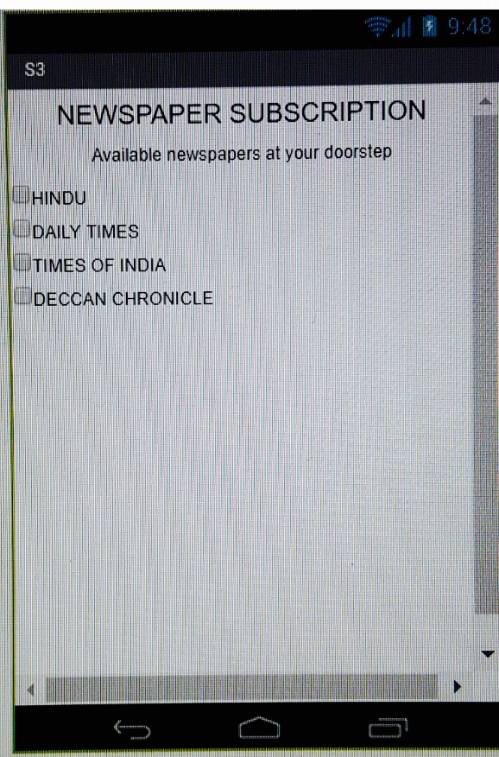
SELECTION FROM AVAILABLE OPTIONS

Slide 21
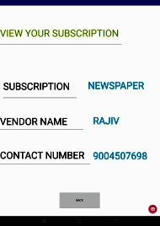
To view their subscription

Slide 22
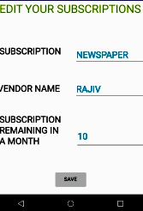
To edit their subscriptions

Slide 23
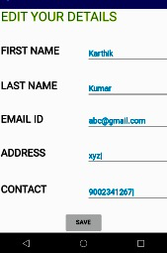
To edit their details such as address

Slide 24
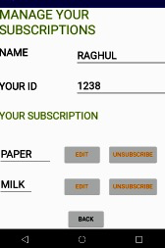
To manage their subscriptions

Slide 25
Thank you

